Slide 1
TCoE – Technical Testing
Agile/DevOps Test Automation Framework

Slide 2
Agile Test Framework – Objective
Implement a test automation framework integrated with DevOps to enable Shift Left testing and support use of Selenium by TestDev Agile team members.

Slide 3
Agile Test Framework – Driving Features
Speed of testing
Dev-Test collaboration
Complement Dev ecosystem
Reusability
Test Data Management
Test Management Integration
Easier Maintenance
Integration with CI/CD tools
Reporting test results

Slide 4





Agile Test Framework – Key Tools/Components
UI Automation framework
Implementation Technology
Unit Test
Framework
Dependencies management Tool
Version control
tool
CI/CD Server

Slide 5
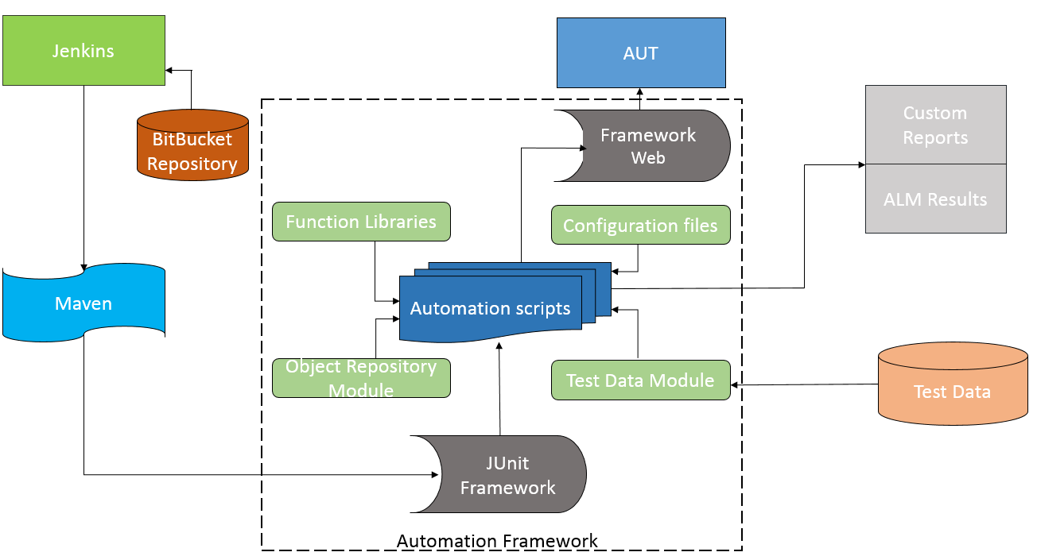
Agile Test Framework - Architecture

Slide 6
Agile Test Framework - Key Modules
UI Automation
Objects Repository Module
Test Data Management
Execution Control
Results Report Management
Test Management Integration
Functional Reusability
Configurable Utility

Slide 7
Agile Test Framework - UI Automation Management
Browser
+ driver: WebDriver
+ pageValues: String[][]
+ rowCount: int
+ columnCount: int
+ foundValue: String[]
+ element: WebElement
+ InitiateBrowser(String): void
+ NavigateURL(String): void
+ Quit(): void
+ Maximize(): void
+ GetBrowser(int): void
+ GetBrowser(String): void
+ ClearCookies(): void
+ ClearCookies(String): void
+ Forward(): void
+ Back(): void
+ Refresh(): void
Association
Page
Composition
ORReader
Composition
WebUIElement
~ b: Browser
~ b: Browser
~ b: Browser
+ Page(Browser)
+ SetCurrentPage(String): void
+ Wait(int): void
+ GetTitle(): void
+ ScrollByPixel(int,int): void
+ ScrollTillEnd: void
+ ORReader(Browser)
+ Properties(String): String[][]
+ FindExactvalue(String): String[]
+ FindProperty(String): Boolean
+ WebUIElement(Browser,String)
+ Webelementlocation(): WebElement
+ Click(): void
+ Exists(): boolean
+ IsSelected(): Boolean
+ IsEnabled(): Boolean
+ IsDisplayed(): Boolean
+ VerifyMessage(String): Boolean
+ Highlight(): void
+ Size(): Dimension
+ GetValue(): String
+ MouseHover(): void
+ AttributeValue(String): String
+ MouseClick(String): void
+ MouseMoveTo(int,int): void
+ PressKey(String,String): void
+ PressKey(String,int): void
Button
TextBox
DropDown
CheckBox
Image
Dialog
+ Button(Browser,String)
+ MouseHover(): void
+ TextBox(Browser,String)
+ SendKeys(String): void
+ Clear(): void
+ ListBrowser,String)
+ SelectedItemByText(String): void
+ SelectIByText(String): void
+ SelectIByValue(String): void
+ SelectIByIndex(int): void
+ GetSelectedText(): String
+ CheckBox(Browser,String)
+ SelectCheckBox(): void
+ DeselectCheckBox(): void
+ Image(Browser,String)
+ Dialog(Browser)
+ Click(): void
+ Close(): void
+ Exists(): void
+ GetVisibleText(): String
+ SendKeys(String): void
RadioButton
Label
WebElement
Hyperlink
Table
+ RadioButton(Browser,String)
+ SelectRadioButton(): void
+ DeselectRadioButton(): void
+ Label(Browser,String)
+ WebElement(Browser,String)
+ Hyperlink(Browser,String)
+ Table(Browser,String)
+ DimensionCount(): int
+ RowCount(): int
+ ColumnCount(): int
+ GetMax(int[]): int
+ GetCellData(int,int): String
+ GetRowWithCellText(String)

Slide 8
Agile Test Framework - UI Automation Management
Web
Mobile
Browser
APPIUM
Composition
Composition
Page
ORReader
WebUIElement
Button
TextBox
List
CheckBox
Image
Dialog
Desktop
RadioButton
Label
WebElement
Hyperlink
Table
DESKTOP AUTOMATION TOOL

Slide 9
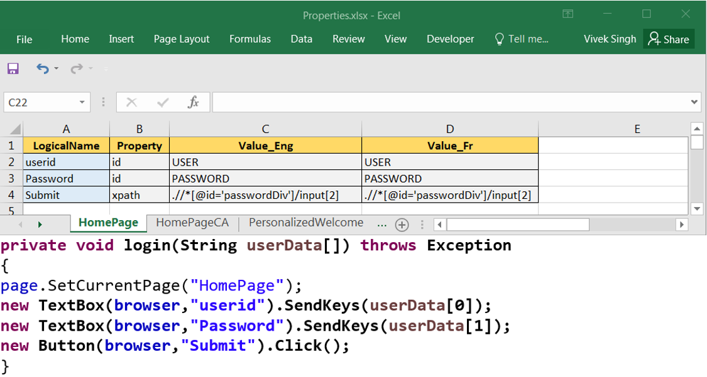
Agile Test Framework - Object Repository Module

Slide 10
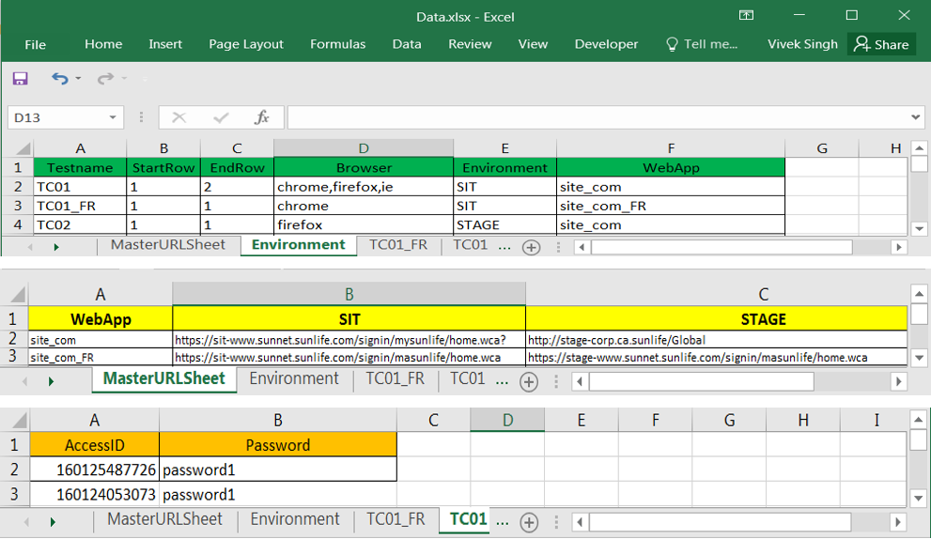
Agile Test Framework - Test Data Management Module

Slide 11
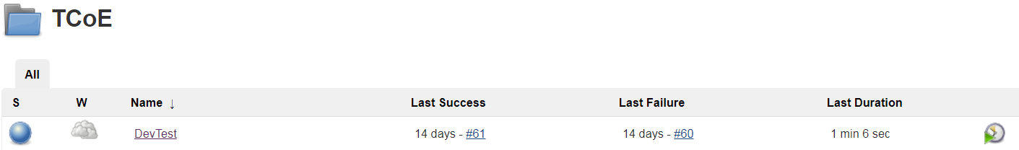
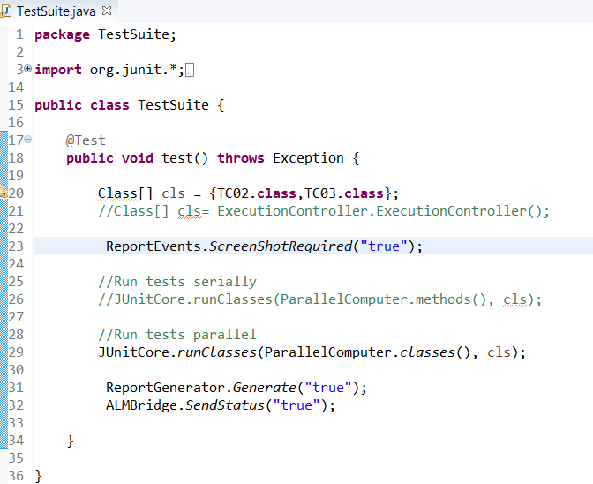
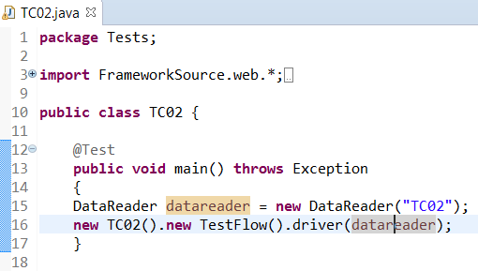
Agile Test Framework - Execution Control Management
Jenkins
TestSuite.java
TC02.java

Slide 12
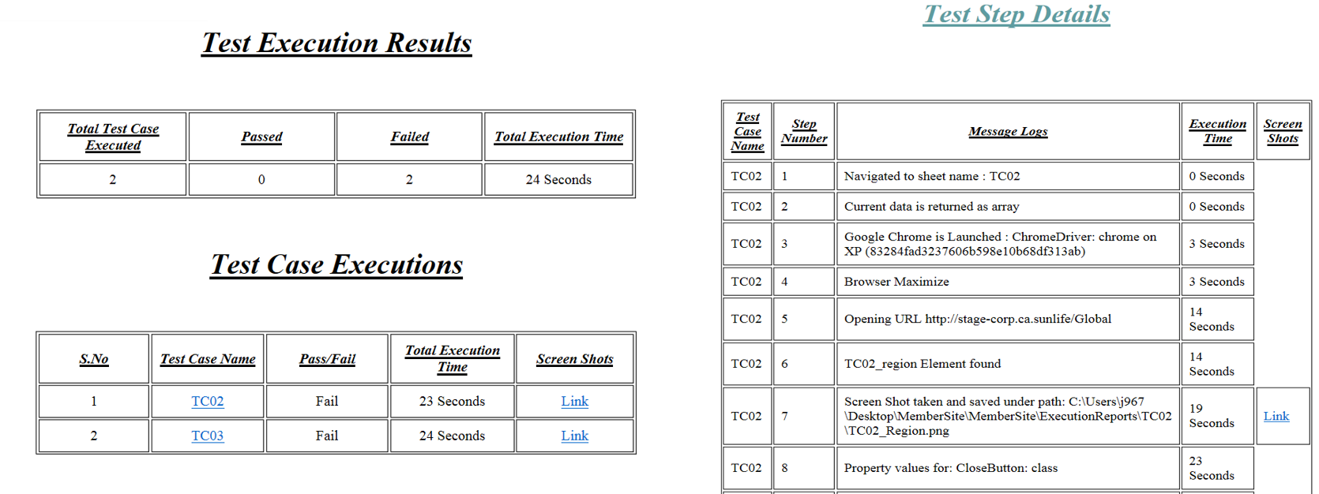
Agile Test Framework - Execution Reports

Slide 13
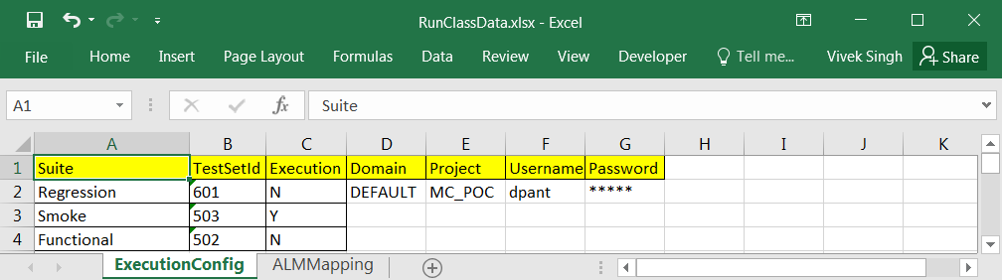
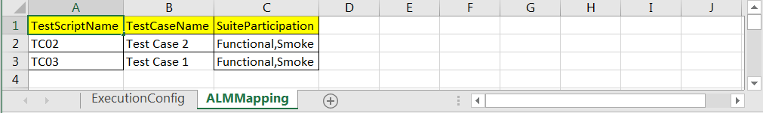
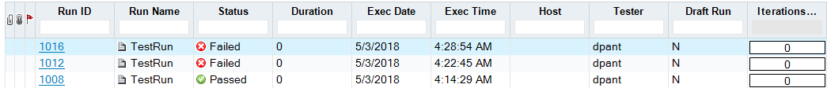
Agile Test Framework - Test Management Integration

Slide 14
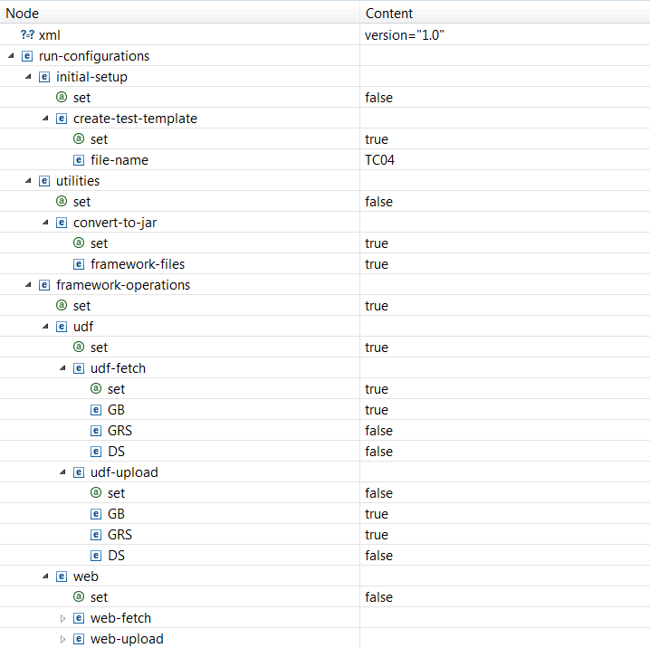
Agile Test Framework - Utility

Slide 15
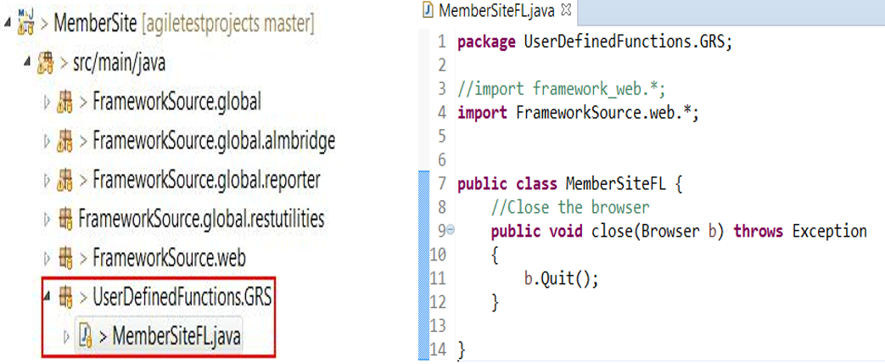
Agile Test Framework - Functional Reusability Management

Slide 16
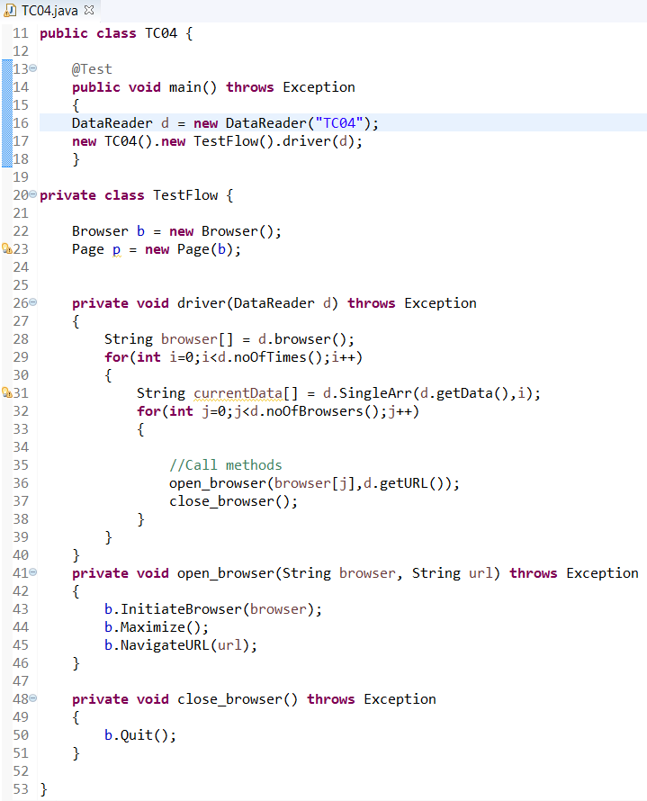
Agile Test Framework – Sample Test Script

Slide 17
Agile Test Framework v/s Pure Selenium Framework
Features | Agile Test Framework | Native Selenium
Design Effort | Easy to design scripts because of ready to use framework classes and methods | Every time script to be design from scratch
Low-cost maintenance | Framework introduces the high level of modularization which leads to easier and cost-efficient maintenance. | Cost of maintenance is high
Reusability of code | Provides reusable methods helps reducing effort. | Reusability is missing.
CI/CD Integration | Integrated with Jenkins to trigger scripts in CI/CD pipeline. | No implicit integration
Centralized Test Data Repository | Test data is maintained separately from test script for easy access and maintenance. | Test data is maintained inside scripts leading to higher maintenance
Ready to use Modules | User Defined Module which can be utilized between multiple Lobs/projects. | Redundancy of code
UI Object Classes | Encapsulation of actions perform on Objects in Classes to provide structured approach | Individual classes with no structure
Execution Control | Ability to customize execution control via different settings. Thus gives more options of executing tests serial/parallel | Ability to customize execution control via different settings. Thus gives more options of executing tests serial/parallel
Reporting Capabilities | Generation of reports based on different stakeholders and platforms. | Dependent on dev tester to report
Object Identification | Standard approach for identification of Objects. | No approach, depends on devtester how he/she judge to automate objects.
Test Management Integration | Support for adding test run results with different test sets. | No integration with Test Managament tool.

Slide 18
Agile Test Framework - Way Forward
Review of the framework with tech architects is in progress.
A formal signoff and approval to be taken.
Identified projects to pilot the framework.
Work on the enhancements backlog.

Slide 19
Agile Test Framework – Future Enhancements
Implementing BDD(cucumber) approach
Extend for Mobile test automation (Appium)
Extend for API test automation
Support Unit testing
Implementing Visualizations(Tableau)

